Slide 1
ParallelJS: An Execution Framework for JavaScript on Heterogeneous Systems
Jin Wang†, Norman Rubin‡, Sudhakar Yalamanchili†
† Georgia Institute of Technology
School of Electrical and Computer Engineering
‡ NVIDIA Research

Slide 2
JavaScript on Modern Architectures
Widely used
Security
Limited to execute in a sandbox
Link external library (C/C++) through extensions
Portability
Independent of system configuration on different platforms
5-20 million programmers
PC
Server
Mobile

Slide 3
JavaScript Compilation
Just-in-time Compilation
Example:
Google V8
Mozilla Firefox SpiderMonkey
Single-Threaded
Conserves determinism
Fails to utilize modern parallel architectures

Slide 4
This Work
Goal: Efficiently use modern heterogeneous architectures (CPU and GPU) for JavaScript execution.
Strategy:
High-level Parallel JavaScript Constructs
Dynamic compilation and execution flow on heterogeneous architectures
Portability: constructs can execute on both CPU and GPU

Slide 5
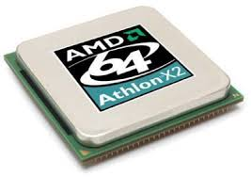
System Overview
ParallelJS Program
ParallelJS Compiler
Error or GPU not available, diverted to CPU execution
Native JavaScript Compiler
LLVM IR
ParallelJS Runtime
CPU
GPU

Slide 6
ParallelJS Program
Define High-level Parallel Constructs
Use same syntax defined by regular JavaScript
No extra language binding like WebCL^{[1]}
Root Object:
par$
map
reduce
find
filter
reject
every
some
scatter
gather
sort
scan
AccelArray
Utility Constructs
Basic Datatype
[1] Khronos. Webcl working draft. 2013.

Slide 7
Construct par$.map
Example Syntax:
out = par$.map(input, function, [context])
Multiple Inputs/Outputs (all should be AccelArrays)
Element-wise function
Support operations on multiple inputs and generating multiple outputs
Support neighbor element access
Context
Handle identifiers defined outside lexical scope of function

Slide 8
Construct par$.map (Cont.)
Implementation on CPU:
As a loop: each iteration for one element
No syntax restriction for function, anything can run on CPU
Implementation on GPU:
Each thread handles one element
Syntax restriction for function
Basic control flows
Side-effect free
Complex control flow cannot be handled by GPU
No race condition when executed in parallel

Slide 9
Construct par$.reduce
Example Syntax:
out = par$.reduce(input, function, [context])
Implementation on GPU
logN (CTA-wise and inter-CTA) parallel implementation scheme
Usage of shared memory on GPU
Detailed implementation can be architecture-dependent and is hidden from programmers
Programmers don’t see memory hierarchy in ParallelJS code, yet shared memory can be used to boost performance

Slide 10
High-Level Programming Methodology
ParallelJS programs are typically smaller then CUDA codes
Productivity and Performance portability
Detailed Implementation Scheme
Grid/CTA/Threads
ParallelJS Programmer
Global/Shared/Local Memory
GPU-dependent Configurations
Invisible to programmers
High-level
Constructs

Slide 11
Example – Sum of Squares
var numbers = new par$.AccelArray([1,2,3,4,5,6]);
function square(x){return x * x;}
function plus(x, y){return x + y;}
var sum = numbers.map(square).reduce(plus);

Slide 12
Compilation for GPU
Esprima^{[2]}
AST
User-defined Function
Parsing
ParallelJS Program
Type Inferernce
Written in JavaScript
Construct LLVMIR Library
Parallel Construct
Code Generation
LLVM IR
NVVM Compiler
Through Dynamic C++ Lib
PTX
[2] A. Hidayat. Esprima: Ecmascript parsing infrastructure for multipurpose analysis. http://esprima.org/.

Slide 13
Compilation (Cont.)
AST: stored in JavaScript objects
Type Inference
JavaScript is dynamically typed
Type propagation from input types
Avoid iterative Hindley-Milner algorithm
Code Generation
Add Kernel Header and Meta to comply with NVVM
AST->LLVM Instructions
NVVM: Generate PTX from LLVM

Slide 14
Runtime System (on Windows Mozilla Firefox)
LLVM IR
NVVM Lib
Firefox Extension
Runtime Library
Inputs
CUDA Driver
Outputs
General JavaScript
Privileged JavaScript
Dynamic C/C++ Library
DOM Event Passing
ctypes Interface
DOM: Document Object Method

Slide 15
Runtime System Cont.
Data Transfer Management
Copy data only when accessed by CPU or GPU
Garbage collector is utilized to reuse GPU memory
Code Cache
ParallelJS Construct code is hashed
Future invocation of the same code does not need recompilation
Initial Copy
Reuse
CPU (JS)
GPU
Access Copy
Construct
1st
2nd, 3rd, …
Compile
Cached
Kernel
GPU

Slide 16
Example Programs
Boids Simulation
Chain (Spring connection)
Mandelbrot
Reduce
Single Source Shortest Path (SSSP)
Use par$.map
Use par$.reduce
Use par$.map and par$.reduce

Slide 17
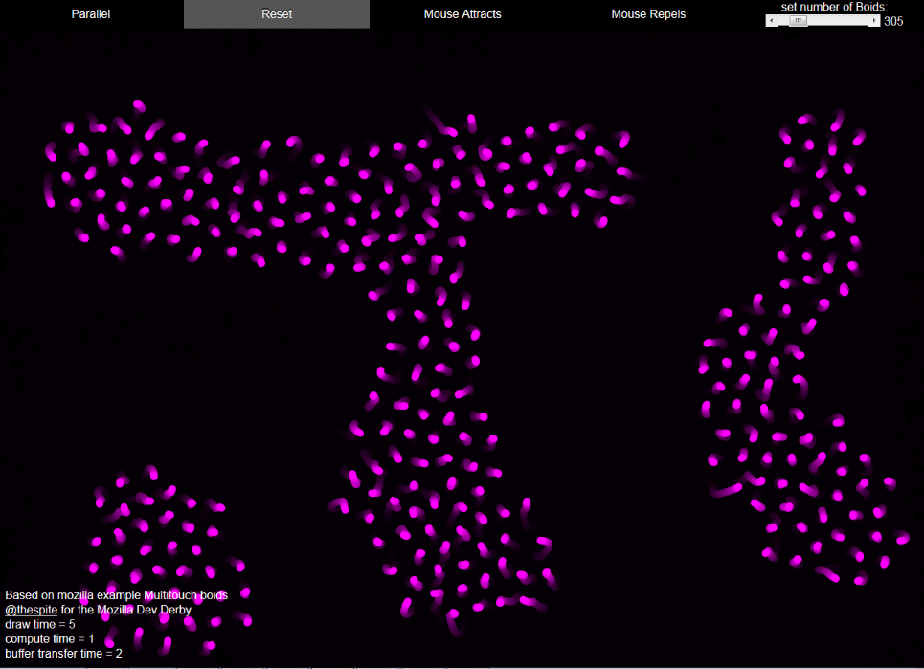
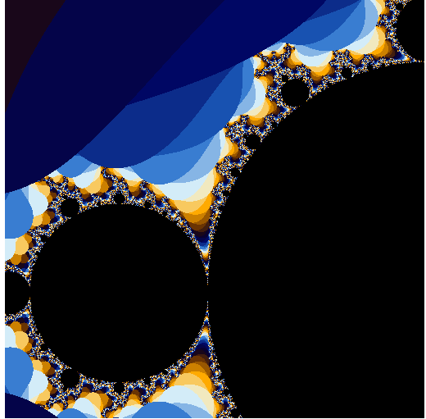
Example Programs (Cont.)
Chain
Boids
Mandel

Slide 18
Example Program (Cont.)
Common code structure of Boids, Chain and Mandel
1 //Sequential JavaScript code
2 function seqfn(...) {
3 for(var x = 0; x < width; x++) {
4 for(var y = 0; y < height; y++) {
5 var xy = ...computation of point (x,y)...
6 result[y*width+x] = xy; }
7 }
8 }
9
10 //ParallelJS code
11 function parfn(input, index) {
12 var xy= ...computation of point (x,y)...
13 return xy;
14 }
15 par$.map(input, seqfn);
Computation body of sequential code can be used directly in ParallelJS

Slide 19
Experiments Platform
High-end desktop
CPU: Intel i7-4771 @ 3.5GHz
Memory: 32GB
GPU: Geforce Titan (Kepler GK110) @837MHz, 2688 cores, 6GB Mem
Low-end business class laptop
CPU: Intel i7-2630QM @ 2.0GHz
Memory: 6GB
GPU: Geforce GTX525M (Fermi) @600MHz, 96 cores, 1GB Mem
OS and browser
Windows 8
Mozilla Firefox
Google Chrome

Slide 20
Performance Result
Small Input: ParallelJS is slower due to overhead takes most time
Larger Input: ParallelJS is 5.0x-26.8x faster on desktop, 3.8x-22.7x faster on laptop

Slide 21
Performance Result (Cont.)
Performance of Reduce compared with native CUDA, and CUB library
For large input, ParallelJS has similar performance, but incredibly smaller code size

Slide 22
Performance of SSSP
Compare with CUDA SSSP (lonestar benchmark^{[3]}) on GPU
ParallelJS is always worse
Use backward algorithm instead of forward algorithm used by CUDA
Inevitable because JavaScript does not support atomic operation
The limit of current ParallelJS framework: does not support complex GPU features
Graph | Nodes | Edges | Time(ms) | Speedup
USA-Road | 1,070,376 | 2,712,798 | 18,685 | 0.86
ra-2e20 | 1,048,576 | 4,194,304 | 1,215 | 0.6
Rmat20 | 1,048,576 | 8,259,994 | 3,645 | 0.59
[3] M. Kulkarni, M. Burtscher, C. Cascaval, and K. Pingali. Lonestar: A suite of parallel irregular programs. In ISPASS '09: IEEE International Symposium on Performance Analysis of Systems and Software, 2009.

Slide 23
Performance Breakdown for Boids_2K example on laptop
ParallelJS
13ms¶
LLVM
Code Cache
14ms¶
PTX
Privileged JavaScript
Data Transfer
Kernel Execution
C/CUDA
1ms¶
1.92ms*
5.82ms*
¶ : Measured in JS
*: Measure in CUDA

Slide 24
Compare with Related Work
WebCL
Foreign language binding into JavaScript
Programmers need to learn OpenCL
JSonGPU^{[4]}
Expose GPU concepts to JavaScript programmer
Complicated programming API
RiverTrail^{[5]}
Prototype: uses OpenCL backend, tends to use extra memory
Production: more focus on SSE, and multi-core
Ex. HJ.threadID.x, HJ.blockID.x
HJ.setupKernel(…)
[4] U. Pitambare, A. Chauhan, and S. Malviya. Just-in-time acceleration of javascript.
[5] S. Herhut, R. L. Hudson, T. Shpeisman, and J. Sreeram. River trail: A path to parallelism in javascript. SIGPLAN Not., 48(10):729{744, Oct. 2013.

Slide 25
Conclusion
ParallelJS: a framework for compiling and executing JavaScript programs on heterogeneous systems
Use high-level constructs to hide GPU-specific details
Automating the decision of where to run the code
Productivity and performance portability
Limited use of advanced features of GPU
Future direction
Embedded and fused architectures
Adaptive decision of running on CPU/CPU for power efficiency
Support of advanced GPU features

Slide 26
Thank you!
Questions?

