Slide 1
Accelerating Simulation of Agent-Based Models on Heterogeneous Architectures
Jin Wang†, Norman Rubin‡*, Haicheng Wu†, Sudhakar Yalamanchili†
† Georgia Institute of Technology
‡ AMD
* The author is now affiliated with NVIDIA Research

Slide 2
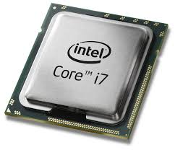
Discrete Heterogeneous Architectures
Discrete GPU and CPU connected by PCIe bus
Powerful GPUs and CPUs
Slow PCIe bus
Compute Unit
Compute Unit
Device Memory
Host Memory
Compute Unit
Compute Unit
PCIe bus
Compute Unit
Compute Unit
Compute Unit
Compute Unit
GPU (e.g. AMD Southern Island)
CPU (e.g. Intel Core i7)

Slide 3
Integrated Heterogeneous Architectures
CPU and GPU one the same die
Less powerful CPU and GPU
Faster On-chip Memory Bus
E.g. AMD Fusion APU
Physical Memory
Host Mem
Dev Mem
L2
WC
UNB
CPU
GPU
GPU
Compute Unit
Compute Unit
CPU
Compute Unit
Compute Unit
System Memory

Slide 4
Agent-Base Model on Heterogeneous Architectures
Agent-based Model:
Time-step or event-driven simulation of a group of agents with states
On Discrete GPU:
Intrinsic Parallel structure for GPU implementations
CPUs only transfer data and are idle most of time
On Integrated Architectures:
More computation capability can be extracted from CPU
Agent States
Transit Functions
Updated States
Agent States
Updated States
Agent States
Updated States

Slide 5
This Work
Goal: Efficiently use integrated CPU-GPU architectures for agent-based model simulations
Proposed:
A massively parallel implementation of agent-based model on GPUs
An optimization for integrated architectures that moves a portion of computation to CPU
Uses Traffic Simulation as an example for Agent-based Model

Slide 6
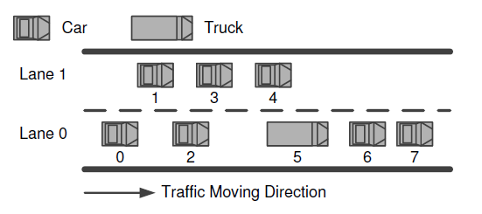
Traffic Simulation
xPosition
Agent-based Model Simulation
Two-lane Traffic
Depends on close neighbors
States
velocity
xPosition
Lane
vehicleType
Transit Functions
Acceleration Function: Depends on preceding neighbor
Lane-change Function: Depends on preceding and back neighbor on both lanes
Three neighbors: Preceding neighbors in both lanes / back neighbor in the other lane

Slide 7
GPU Massively Parallel Implementation
Data structure for states
Structure of Arrays
Sorted according to x positions
Stored in Global Memory
Mapping
One work-item for one vehicle
A work-group for a block of vehicles
Three steps
Locate Neighbors
Update States
Sort states according to x positions
Kernel 1
Kernel 2

Slide 8
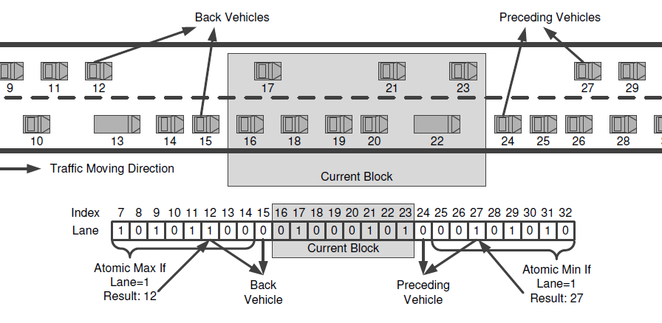
Locate Neighbors
Target: locate neighbors from mixed lanes
Two stages, both of which have BSP structure
Stage 1: Locate group neighbors
Stage 2: Locate individual neighbors within a group

Slide 9
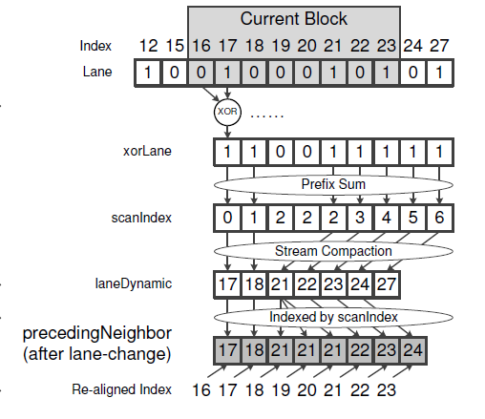
Locate Neighbors Cont.
Stage 1: Locate group neighbors
Stage 2: Locate individual neighbors within a group
Load group neighbors with current block to local memory

Slide 10
Update States and Sort
For each vehicle (mapped to each work-item)
Get the neighbor index (from “locate-neighbor” step)
Load neighbor data (velocity, xposition)
Compute new acceleration, velocity and xposition according to neighbor data using the transit functions
Store the newly update states to global memory
Sort vehicles according to x position
Sort is necessary because
Lane-changing
One lane is moving faster than the other
In other agent-based model:
Restructuring mechanism the same as or similar to sorting

Slide 11
Experiments Platforms
Discrete Platform:
GPU: AMD Radeon HD7950
Southern Island (GCN)
28 Compute Unites
850MHz
CPU: Intel Core i7-920
2.66GHz
4 CPU Cores / 8 Threads
Integrated Platform:
AMD Trinity APU A10-5800K
4 CPU Cores
HD7660D GPU
Northern Islands (4-way VLIW)
6 Compute Unites
800MHz

Slide 12
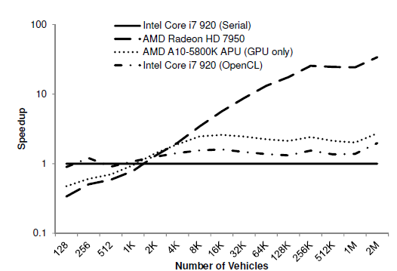
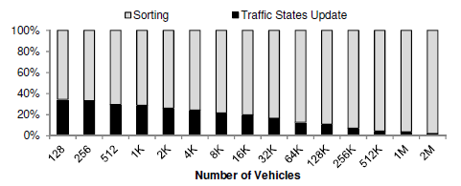
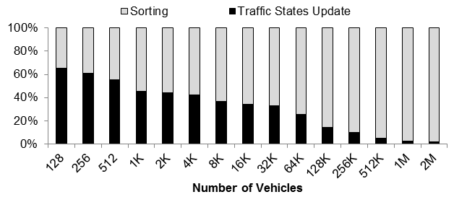
Performance for GPU Implementation
Sort consumes lots of time!
Radix Sort
Bitonic Sort
Odd-Even Sort

Slide 13
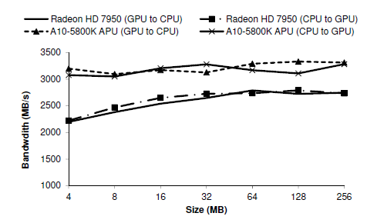
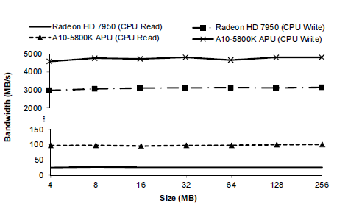
Optimization for Integrated Architectures
Move some computation to CPU
Utilize faster on-chip memory bus
Non-zero copy memory access
zero copy memory access

Slide 14
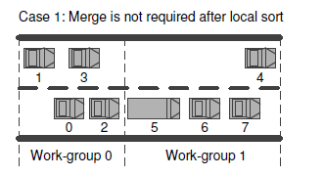
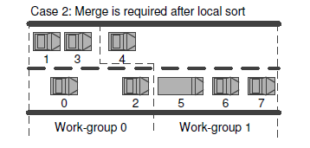
Optimization: Local Sort and CPU Merge
Most of time: sort is only required within block (local sort)
Some time: merge required across blocks

Slide 15
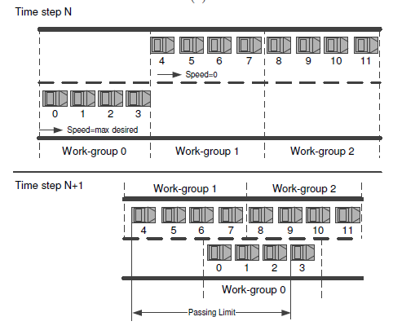
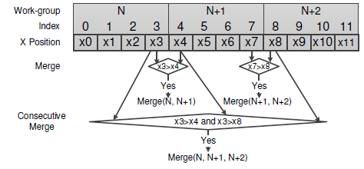
Optimization: Local Sort and CPU Merge Cont.
Merge neighbor blocks on CPU if necessary
Compare max X Position in current block with min X Position in the next block
There can be consecutive merge
Maximum consecutive blocks to be merged

Slide 16
Benefit of Proposed Optimization
Reduce global workload
Merge algorithm is serial and can have CPU as its more natural venue
Communication between CPU and GPU for merge stage is faster on integrated platform through on-chip memory bus

Slide 17
Results
Speedup over pure GPU implementation on Discrete Platform
Even worse than baseline

Slide 18
Results Cont.
Breakdown for States Update / Sort / CPU Merge

Slide 19
Results Cont.
Breakdown for States Update / Sort / CPU Merge

Slide 20
Results Cont.
Breakdown for States Update / Sort / CPU Merge

Slide 21
Conclusion
Optimization of agent-based model on Integrated Architectures through traffic simulation problem
Utilize computation capability of both CPU and GPU
Memory access from host to device is faster through the on-chip memory bus
Provides insight to mapping traditional GPGPU applications to integrated architectures

Slide 22
Thank you!
Questions?

Slide 23
Appendix: Traffic Simulation Models
velocity
distance to front vehicle
Acceleration Model
Lane-changing Model
Interact with front vehicle before/after lane-changing, back vehicle after lane-changing
s’ > minGap
s’’ > minGap
acc' (M') - acc (M) > p [ acc (B') - acc' (B') ] + a_{thr}
Reference: Martin Treiber and Arne Kesting. An open-source microscopic traffic simulator. Intelligent Transportation Systems Magazine, 2(3):6{13, Fall 2010.
velocity difference from front vehicle
acc(B’), acc’(B’)
s'
s''
acc’(M’)
acc(M)

